Slide 1
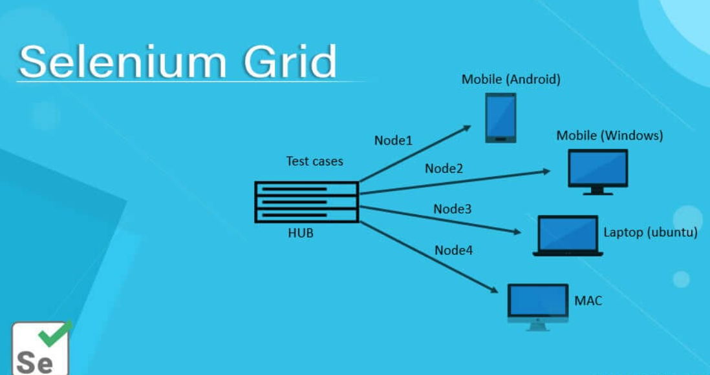

Slide 2

Selenium Grid
tool that allows you to run Selenium tests in parallel across multiple machines and browsers
uses a hub-and-node architecture to distribute test execution
Ideal for cross-browser and cross-platform testing

Slide 3
Selenium Grid Architecture
Hub communicates with nodes via RemoteWebDriver
Nodes register themselves with the hub using a configuration file or command-line flags.
Component | Role
Hub | Central controller that receives test requests
Node | Remote machine that executes tests on a specific browser/OS

Slide 4

Why Use Selenium Grid
Run
Run tests in parallel to reduce execution time
Test across
Test across multiple OS/browser combinations
Improve
Improve coverage for regression and compatibility testing
Integrate
Integrate easily with CI/CD pipelines

Slide 5
Example Use Case
Scenario: You want to run the same test on Chrome (Windows), Firefox (Linux), and Safari (macOS).
Solution:
Set up one hub
Register three nodes with different browser/OS configurations
Use RemoteWebDriver to send tests to the hub

Slide 6
How to setup Selenium Grid
Download Selenium Server JAR
java -jar selenium-server-4.x.x.jar hub
Start Nodes
java -jar selenium-server-4.x.x.jar node --hub http://localhost:4444
Configure Node Capabilities (Optional)
Use JSON config or command-line flags to specify browser, platform, max sessions
Write Test Using RemoteWebDriver
WebDriver driver = new RemoteWebDriver(
new URL("http://localhost:4444/wd/hub"),
new ChromeOptions()
);

